Slide 1
An Introduction to Industrial and Organizational (IO) Psychology
Chapter 1

Slide 2
Overview
Module 1.1 – The Importance of IO Psychology
Module 1.2 – The Past, Present, and Future of IO Psychology
A Brief History of IO Psychology
Modern IO Psychology

Slide 3
Module 1.1 – The Importance of IO Psychology

Slide 4
Importance of Work
Importance of work in people’s lives
We spend a large percentage of our lives working!
Work is a defining characteristic of the way people gauge their value to society, family, and themselves
The “lottery question”
If you were to get enough money to live as comfortably as you would like for the rest of your life, would you continue to work or would you stop working?
Most people would say no, they would cont. working
Why do we work?
Money
Social status
Achievement and self-realization
Self-definition
Social contacts
Challenges
Taking initiative/responsibility
Notes:
- As time goes on the amount of people who would continue to work if

Slide 5
Concept of “good work” & Authenticity : tend of interest to I/O psych
Good work – is work that “exhibits a high level of expertise and it entails regular concern with the implications an applications of an individuals work for the wider world”
Good work harder to do then it seems
good work project – directed towards identifying or creating good work
Authenticity – referring to what is real and genuine, not artificial

Slide 6
So What Is IO Psychology?
I-O Psychology synonym to industrial and organizational Psychology
“The application of psychological principles, theory, and research to the work setting”
Industrial/Personnel psychology
Focused on improving concrete organizational outcomes (usually job performance)
Organizational psychology
Focused on the social, emotional, and motivational side of work and improving individual outcomes

Slide 7
What Is IO Psychology?
Industrial Psychology
Organizational Psychology
Selection/Assessment
Placement
Job Analysis
Performance Appraisal
CWBs/OCBs
Training
Development
The Law
Motivation
Job Attitudes
Organizational Justice
Organizational Culture/Climate
Leadership
Emotion
Teamwork and Groups
Stress and Health

Slide 8
What Isn’t IO Psychology?
Consumer Psychology - we don’t study what you buy
Human Factors Psychology/Engineering – human factors close, but focuses on designs of work place or tools you use at work, so is not I/O psych
The Business Counterparts
Human Resources – I side,
Organizational Behavior – O side, motivation, leadership

Slide 9
Vocab
Personnel Psychology – field psychology that addresses issues about recruitment, selection, training, performance, appraisal, promotion, transfer, and termination
Seen as a part of HRM
Human Resource Management (HRM) – practice recruitment, selection, training, and development of people (HR) in order to achieve individual and organizational goals
Organizational psych – field of psych that combines research from social psych and organizational behavior and addresses the emotional and motivational side of work
Human Engineering/ Human Factor psych – the study of the capacities and limitations of humans with respect to a particular environment

Slide 10
The Scientist-Practitioner Model
Scientist – Practitioner model: A model that uses scientific tools and research in the practice of 1/o psych
The Scientist: Using scientifically supported principles of research to ask questions about psychology at work
The Practitioner: Using the Scientist’s research to improve individual and organizational outcomes for real organizations
** I/O psych is both scientist and Practitioner

Slide 11
IO Psychology is an Evidence-Based Approach
“Evidence-based management means managerial decisions & org practices are informed by the best available scientific evidence”
(Rousseau & McCarthy, 2007)

Slide 12
What constitutes “evidence”?
Two Types of Evidence
‘Big E’: generalizable info about cause-effect connections derived from scientific methods
Example: specific goals promote much higher goal attainment than do vague goals
‘Little e’: organization-specific, as exemplified by root cause analysis & other fact-based approaches
Example: Six-sigma/total quality management

Slide 13
SIOP as a Resource
Society for Industrial and Organizational Psychology (SIOP; Division 14 of APA)
Established in 1945
Approx. 8,600 members
www.siop.org
History of IO psychology
Membership information (incl. students)
Quarterly newspaper: TIP
JobNet
Educational institutions that offer graduate training programs in I-O psychology
List of SIOP publications

Slide 14
How This Course Can Help You
Knowledge about 21st century workplace
Help you understand your work experiences
Provide a foundation for developing and/or implementing effective work-related policies
Allow you to help others understand how work policies are affecting them
Course will address issues such as work stress, work-family balance, workplace discrimination, & leadership

Slide 15
Module 1.2 – past, present, & Future of IO Psychology
A Brief History of IO Psychology
Modern IO Psychology

Slide 16
A Brief History of IO
1 | 2 | 3 | 4 | 5 | 6 | 7 | 8 | 9 | 10 | 11 | 12 | 13 | 14 | 15 | 16 | 17 | 18 | 19 | 20
21 | 22 | 23 | 24 | 25 | 26 | 27 | 28 | 29 | 30 | 31 | 32 | 33 | 34 | 35 | 36 | 37 | 38 | 39 | 40
41 | 42 | 43 | 44 | 45 | 46 | 47 | 48 | 49 | 50 | 51 | 52 | 53 | 54 | 55 | 56 | 57 | 58 | 59 | 60
61 | 62 | 63 | 64 | 65 | 66 | 67 | 68 | 69 | 70 | 71 | 72 | 73 | 74 | 75 | 76 | 77 | 78 | 79 | 80

Slide 17
The Eras of IO Psychology
Era 1: Infancy
Late 19th century (1876) through the aftermath of World War I (1930s)
Era 2: Change in Focus
1930s through WW2
Era 3: Rapid Growth
WW2 through 1960s
Era 4: The Cognitive Revolution
1960s to present

Slide 18
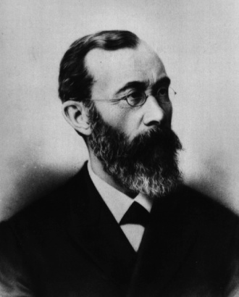
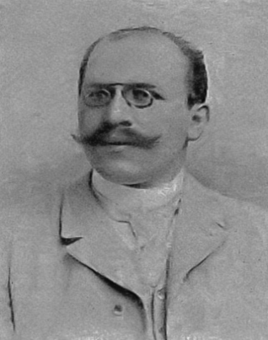
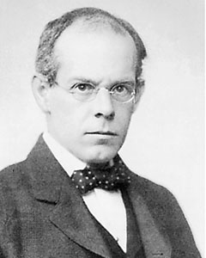
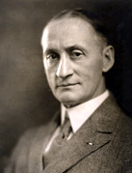
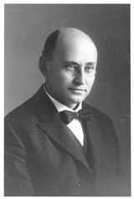
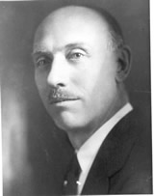
Era 1: Infancy
Psychology - new science
Wilhelm Wundt – father of all psychology/Made 1st psychology lab
Developing IO
Hugo Munsterberg - father of i/o psychology, wrote 1st i/o psych textbook
James Cattell – father of different psych, said people are different/ worked under sir Frances
Harry Hollingworth – ask by coke to study effects of caffeine; found that in normal amounts caffeine enhances performance
World War I
Walter Dill Scott and Walter Bingham – worked at Carnegie Institute developing a way to select and train sales personnel
During WW1 they helped test and place army recruits with the help of the Stanford –Binet Test; that they helped adapt
Stanford-Binet Test: an intelligence test designed to test one individual at a time

Slide 19
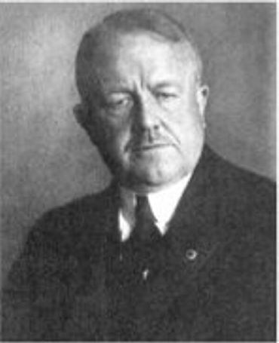
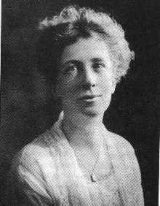
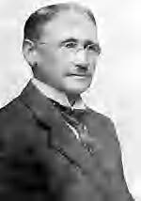
Era 1: Infancy
Time and Motion Studies – studies that broke every action into parts, timed those with a stopwatch and developed new and more efficient movements that would reduce fatigue and increase productivity
Frederick Taylor
Frank and Lilian Gilbreth
1st time and motion study – brick lane
After watching brick layer they helped create scaffolding to make workers not bend over, and made it possible to double the work in the same time
Lilian Gilbreth was awarded the first Ph.D. in Industrial Psychology in 1917
Scientific Management – a movement based on principles developed by Fredrick W Taylor, who said there was 1 best and most efficient way to perform various jobs
Beginning of the Journal of Applied Psychology

Slide 20
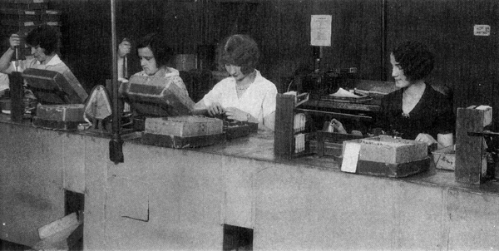
Era 2: Change in Focus
Revery Obsession – Elton Mayo said that the mental state resulted from the mind numbing repetitive an difficult work that characterized US factory worker in early 20th cent. causing workers to be unhappy , prone to resist management attempts to increase productivity and sympathetic to labor unions
Elton Mayo’s Hawthorne Studies
Elton Mayo studied women working in a factory- women working seemed unhappy/ Mayo said their minds were wondering and that caused paranoid thoughts – he tried to change setting nothing made substantial change and found out that worker’s attitudes played in productivity
Human Relations Movement – The results of the Hawthorne studies ushered the movement, which focused on work attitudes and the newly discovered emotional world of the worker

Slide 21

Era 2: Change in Focus
Military Involvement
Henry Murray at the Office of Strategic Services (OSS)
If you worked for the OSS, how would you test to see if someone was mentally stable enough to spy on the Nazis?

Slide 22
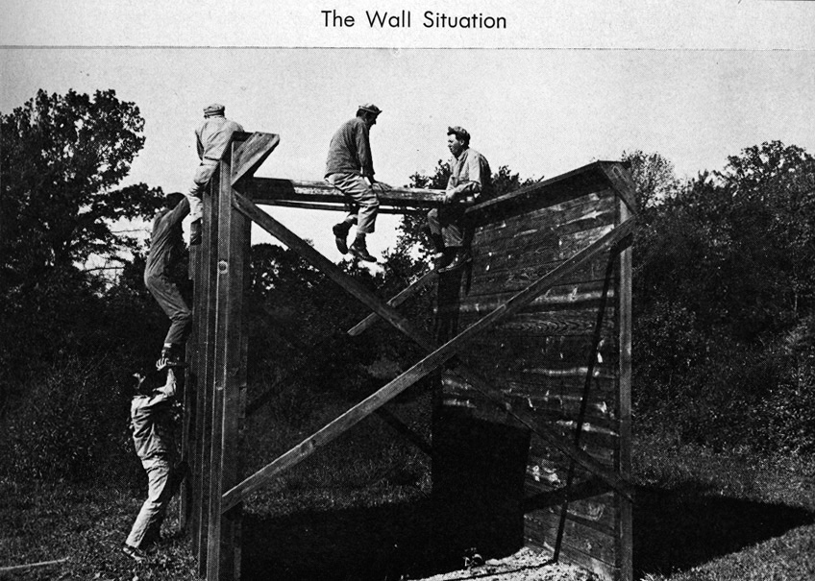
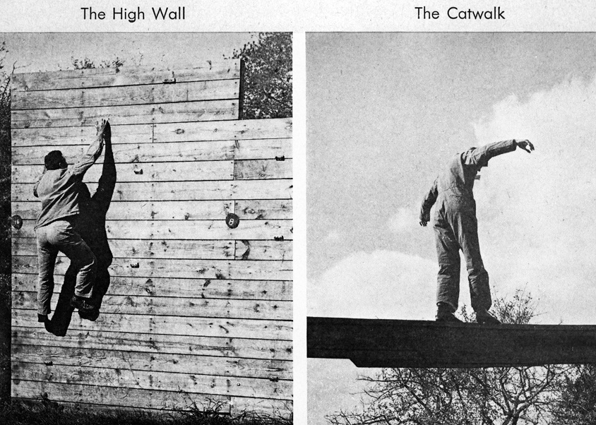
OSS Selection Procedures

Slide 23
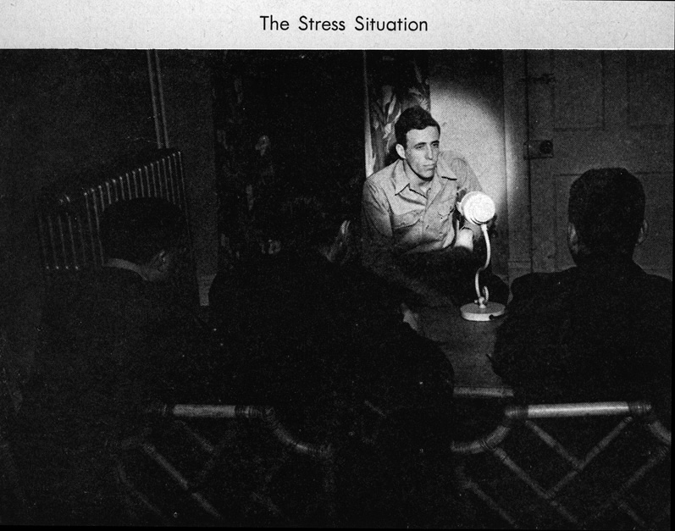
OSS Selection Procedures

Slide 24

OSS Selection Procedures

Slide 25
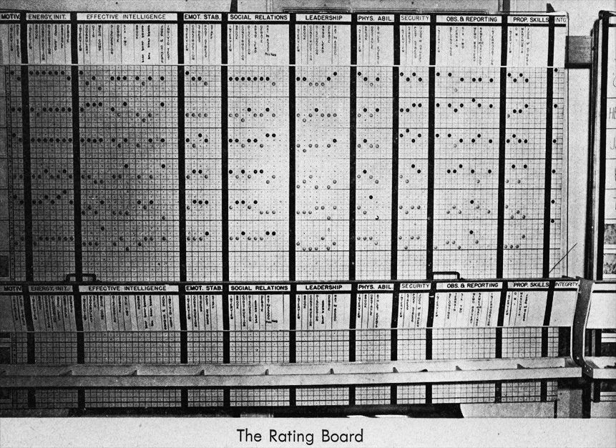
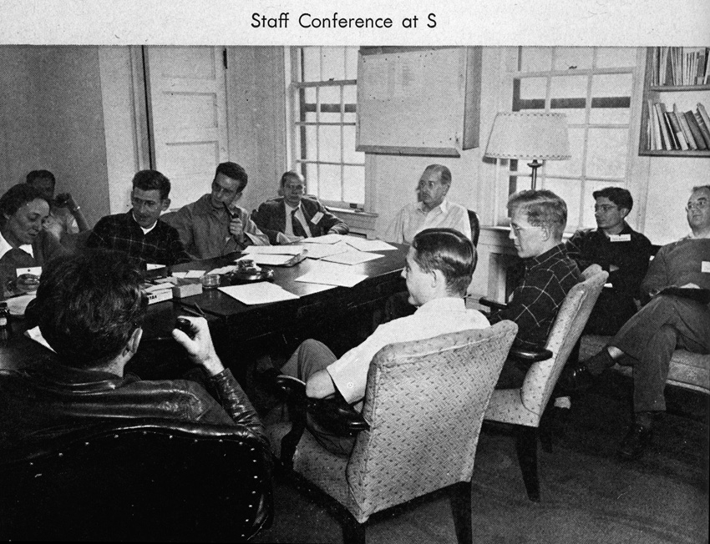
OSS Selection Procedures

Slide 26
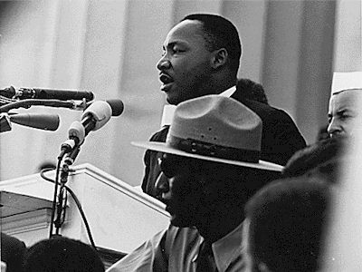
Era 3: Rapid Growth
Post-War Boom - businesses growing after war/ business need i/o psych
The Civil Rights Movement – changed worker demographic
Title VII of the Civil Rights Act of 1964
Explosion of Ph.D.-level training

Slide 27
Civil Rights Act of 1964 & Title VII
Title VII specified demographic groups to be protected from employment discrimination
Groups named in 1964
race
color
gender
national origin
religion
2 additional protected groups added later
ADEA (age) 1967
ADA (disability) 1990

Slide 28
Era 4: The Cognitive Revolution
Looking inside “The Black Box”
Behaviorism fades into the mists
Skinner(behaviorist) said behavior is caused by environment
Increased focus on globalization
Responding to economic forces
New organizational structures
The merits and pitfalls of diversity
Validity generalization
Workplace stress, aggression, violence – impacts of downsizing
Workplace
Interventions
???
PROFIT!!!

Slide 29
Modern IO Psychology

Slide 30
Demographics of IO Psychologists
In 2012, IO psychologists represented about 4% of all APA members
In 2012, 45% of IO psychologists in SIOP were women
2015 Median salaries:
Ph.D. in IO psychology: $119,000
Masters in IO psychology: $85,000

Slide 31
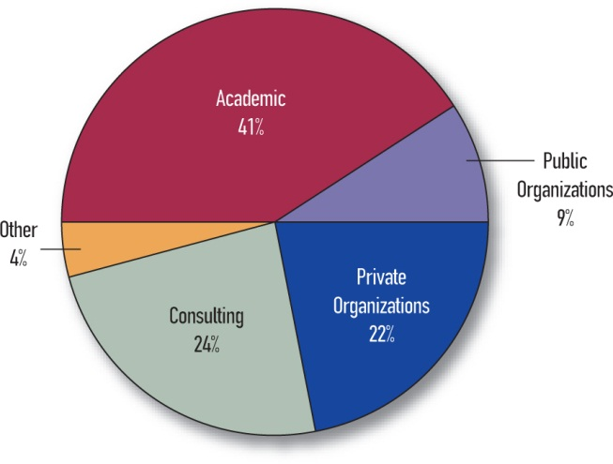
Where IO Psychologists are Employed

Slide 32
Changes in the Workplace Since 1980
Personal computing
Telecommuting & virtual teams
Videoconferencing
Providing a service vs. manufacturing “goods”
Nature of work more fluid
Teams vs. the individual
Little stability
Family-friendly workplaces
Greater diversity
Global workplace

Slide 33
Challenges to IO in the 21st Century
IO psychology needs to be:
Relevant – need to study the problems of today, not those of yesterday
Useful – put research into practice
Grounded in scientific method – careful and systematic observation, development of hypotheses that can be tested, collection and analysis of data, and logical connection between data and interpretations

Slide 34
Relatively New Topics of Interest to I-O Psychology
Building sustainable and environmentally conscious organizations
Humanitarian work psychology (HWP): application of I-O psychology to humanitarian arena, especially poverty reduction and promotion of decent work, aligned with local stakeholders’ needs, and in partnership with global aid/development groups
The aging workforce
Multicultural and multinational work

